Slide 1
Operators and expressions
By
Sana Mateen

Slide 2
Operator in java is a symbol that is used to perform operations. For example: +, -, *, / etc.
There are many types of operators in java which are given below:
Unary Operator,
Arithmetic Operator,
shift Operator,
Relational Operator,
Bitwise Operator,
Logical Operator,
Ternary Operator and
Assignment Operator.

Slide 3
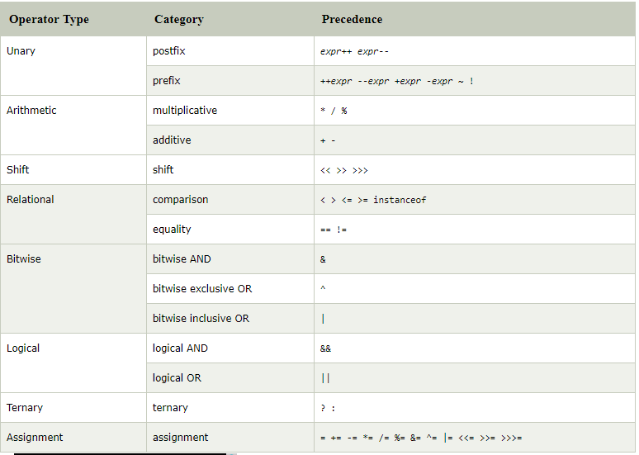

Slide 4
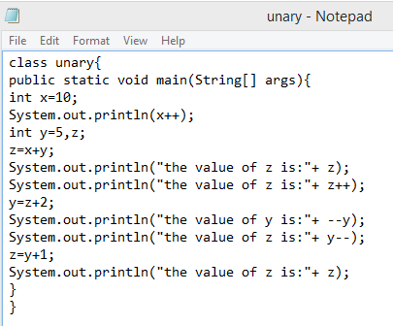
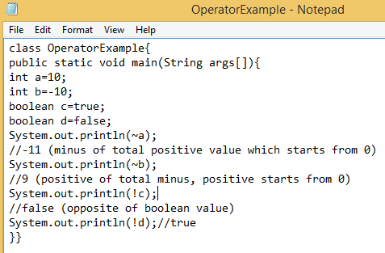
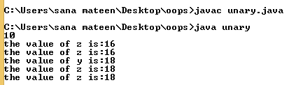
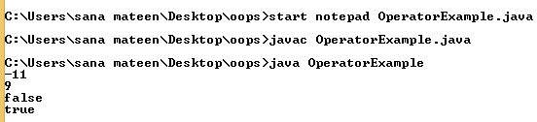

Slide 5
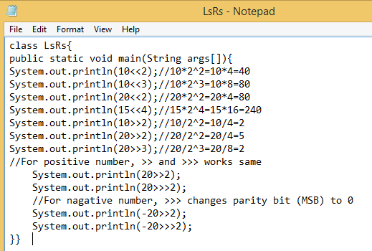
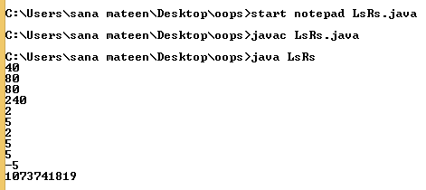

Slide 6
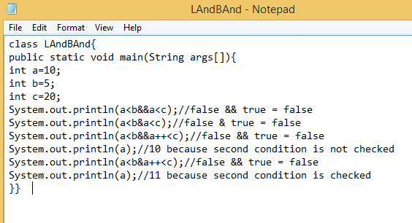
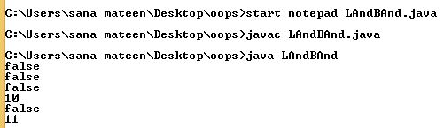
Java AND Operator Example: Logical && and Bitwise &
The logical && operator doesn't check second condition if first condition is false. It checks second condition only if first one is true.
The bitwise & operator always checks both conditions whether first condition is true or false.

Slide 7
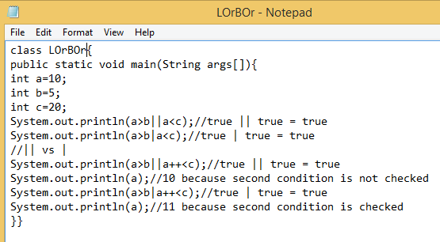
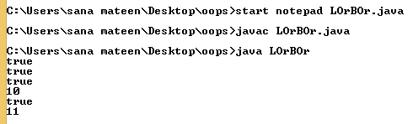
Java OR Operator Example: Logical || and Bitwise |
The logical || operator doesn't check second condition if first condition is true. It checks second condition only if first one is false.
The bitwise | operator always checks both conditions whether first condition is true or false.

Slide 8
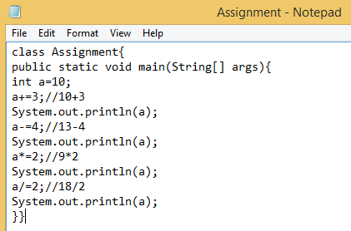
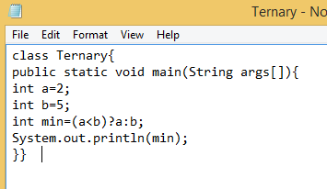
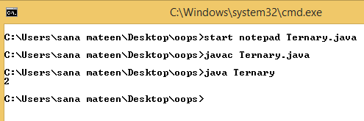
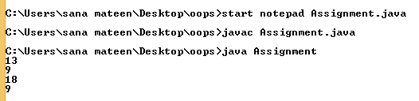

Slide 9
